Slide 1
龙净CV项目第三次汇报
汇报人：朱占宸
日期：2021.8.15

Slide 2
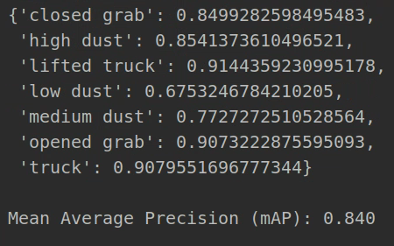
Test_data

Slide 3
 |  | Accuracy
 |  | Train_data | Test_data
1 | lifted truck | 0.905 | 0.914
2 | truck | 0.906 | 0.908
3 | opened grab | 0.867 | 0.907
4 | closed grab | 0.767 | 0.849
5 | low dust | 0.761 | 0.675
6 | medium dust | 0.692 | 0.773
7 | high dust | 0.638 | 0.854
Train_data:7817
(每个object各1000)
Iteration:50

Slide 4
测试视频

Slide 5
感谢聆听！

